Slide 1

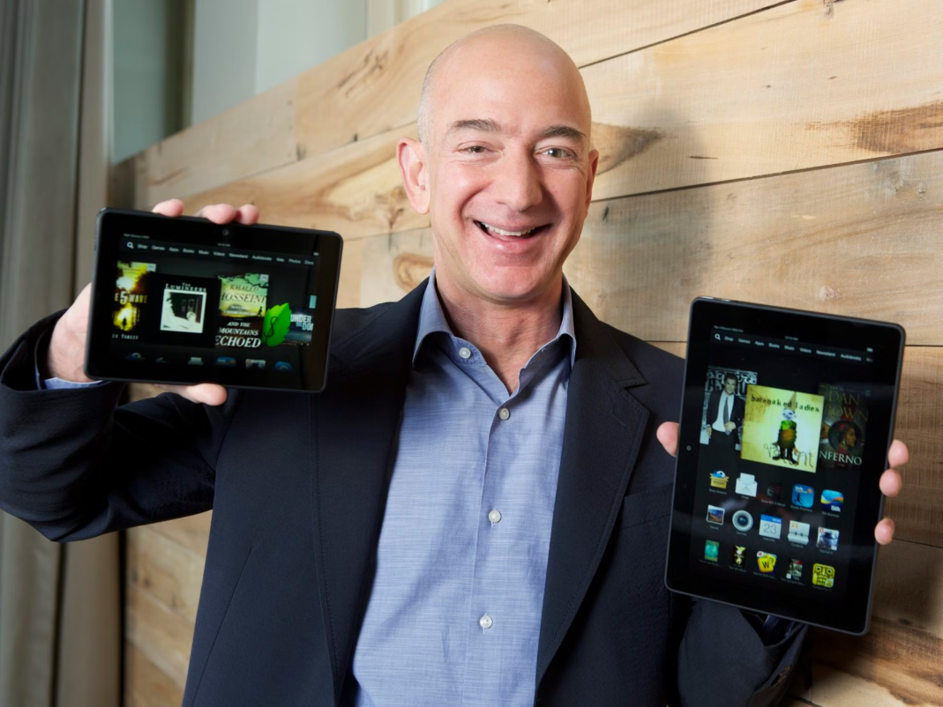

Bezos WayBeats

Slide 2

Discover your perfect journey with the Ultimate Route Navigator and get personalized Spotify recommendations along the way.
The main business idea is to enhance the commuting experience by seamlessly combining navigation and entertainment. Users can enjoy a tailored listening experience while traveling, making their journey more enjoyable and less stressful.
Notes:
• This app combines navigation, personalized music, and travel info to enhance your commute • It provides the optimal route, tailored Spotify recommendations, historical facts, weather updates, and destination imagery • All of this is integrated into a single convenient platform for a seamless experience • The app leverages various APIs to bring you this comprehensive set of features • This allows you to enjoy an enriched commute with both practical guidance and entertainment

Slide 3

Leveraging Robust APIs for Reliable Data
Destination Insights
Route Calculation
Wikipedia API
Google Maps Directions API
Unsplash API
OpenWeather API
1
2
3
Personalized Music
Spotify Web API
Notes:
Route Calculation The app fetches the optimal route based on real-time traffic data, providing step-by-step navigation to ensure a smooth and efficient journey. Destination Insights The app provides a wealth of information about your destination, including historical facts, weather updates, and stunning imagery, enriching your travel experience. Personalized Music The app offers personalized song or podcast recommendations tailored to your preferences and the duration of your trip, enhancing your commuting experience with the perfect soundtrack.

Slide 4
Intuitive App Experience
Simple Input
Personalized Music
Enter starting and destination to get route and recommendations.
Select preferences for tailored Spotify playlist.
Comprehensive Info
Interactive Map
View route, travel time, weather, facts, and destination imagery.
Visualize your route and explore the area.

Slide 5





Overcoming Integration Challenges
API Integration
Data Management
Real-Time Accuracy
User Interface
Notes:
API Integration Seamlessly integrating multiple APIs, including Google Maps, Spotify, Wikipedia, OpenWeather, and Unsplash, to provide a comprehensive travel assistant. Data Management Efficiently handling and transforming data from various sources into a cohesive and user-friendly format. Real-Time Accuracy Ensuring the app provides up-to-date information, such as real-time traffic data and weather updates, for a reliable travel experience.

Slide 6



Personalized Spotify Recommendations
Tailored to Your Preferences
Optimized for Travel Time
Enhanced Commuting Experience
Notes:
Tailored to Your Preferences The app's Spotify integration allows it to provide personalized song or podcast recommendations based on your music preferences, ensuring you have the perfect soundtrack for your journey. Optimized for Travel Time The recommendations are tailored to the duration of your trip, so you can enjoy a seamless listening experience without interruptions or the need to search for new music. Enhanced Commuting Experience By combining the convenience of navigation with personalized music recommendations, the app elevates your commuting experience, making the time spent on the road more enjoyable and productive.

Slide 7



Destination Insights and Imagery
Historical Facts
Weather Updates
Destination Imagery
Notes:
Historical Facts The app provides historical information about your destination, using the Wikipedia API to offer insights that can enrich your understanding and appreciation of the place you're visiting. Weather Updates The app integrates weather data from the OpenWeather API, giving you up-to-date information about the current conditions at your destination, helping you prepare for your journey. Destination Imagery The app showcases stunning imagery of your destination, sourced from the Unsplash API, allowing you to visualize the place you're about to explore and build anticipation for your trip.

Slide 8



Strengths and Future Enhancements
Utility and Entertainment
Robust API Integration
Potential for Expansion
Enhancing Commuting Experience
Increasing User Engagement
Future Enhancements
The personalized Spotify recommendations and the integration of various data sources help to keep users engaged and invested in the app, fostering a loyal user base.
The app can be further improved by integrating traffic alerts, road condition updates, and social sharing capabilities, enhancing the user experience and expanding the app's functionality.
The app seamlessly combines navigation, personalized music, and a wealth of travel information, creating a comprehensive and engaging commuting experience for users.
Notes:
Utility and Entertainment The app combines the utility of navigation with the entertainment of personalized music recommendations, enhancing the overall commuting experience. Robust API Integration The app leverages a variety of reliable APIs, ensuring the accuracy and reliability of the information provided to users. Potential for Expansion The app can be further enhanced with additional features, such as traffic alerts, road condition updates, and social sharing capabilities.

Slide 9

Let's get to the good part!
Bezos WayBeats

